Slide 1



Slide 2

OBJECTIVE:
To analyse and understand how the workforce has performed, especially at the departmental level, by comparing the performance of the different departments within the company . This would involve analysing the current commitments of each department.
Furthermore, the analysis and understanding of the data will help in deciding whether the creation of a target-based bonus system is viable in different departments of the company.
Finally, the objective is to present the different models to the senior managers of the company and come to an conclusion of needed bonuses for each department, if any.
The data used is from the just completed annual performance review cycle of the company.

Slide 3

Resume of data:
Department | FTE | Exceeds | Maintains | Under
Sales | 15 | 4 | 11 | 1
Cust. Services | 8 | 1 | 3 | 4
Marketing | 2 | 0 | 2 | 0
Manufacturing | 35 | 2 | 23 | 10
FTE – Full-time employees.
Exceeds – Exceeds expectations is highest rating for those who are high performers.
Maintains – Regularly hits set targets.
Under – Under-performing employees, who do not reach set targets.
The basis of these targets are: Sales – Total value of sales per week.
Customer services – Average call handling times and value of upselling completed Marketing – Customer retention and repetition and increasing website traffic.
Manufacturing – Number of completed on time builds per month and less than one manufacturing defect per month.

Slide 4

Analysis
In the chart below, we can see the number of employees per department.

Slide 5
Targets
The percentage correlation between the features.
• Sales has the highest rate of exceeds.
• Marketing has not demonstrated its efforts
• Customer Services has the highest rate of under-performing.

Slide 6

The Sales Team
They rank highest in the expectations of the company, have the lowest percentage of underperforming employees, and have the highest above-average utilisation rates. There needs to be overall improvement in performance in the ‘Maintains’ category.

Slide 7

Customer Services
These are measured by time spent contacting and upselling customers, in which case their performance is the minimum expected by the company. Is this time to talk with customers in an overview really a negative point? It can create good relations between customers and the company.

Slide 8

Marketing
Their goals are customer retention and repeat as well as increasing website traffic. With a team of only two employees, they have maintained their performance in levels the company expects. How can we attract more of these kinds of people?

Slide 9

Manufacturing
They have the largest teams and 28% underperformance rate, which leads to dissatisfaction, delays and rework. A clear definition of goals, and a bonus plan can motivate the team more.

Slide 10

Variable Compensation Plans(VCP)
Independent of fixed salary and linked to results.
Types:
a performance-based reward, linked to a role and payable based on results; or
a measurable incentive, with a direct horizon line and the pay mechanically linked to the result.
a bonus award, has many ways of being realised, but refers to a remuneration conditioned to the results of the employee, team, or the entire company in a particular period.

Slide 11

The benefits of a well designed VCP: Employees who deliver the results required by the company usually get a higher and more motivating remuneration in comparison to their peers in other companies, which results also in the company being seen more attractive from the outside; When the employees of the company feel well remunerated, their performance levels and execution capacity of tasks will naturally go higher in comparison to other companies. Ideal department for VCP: - Salaries Fixed and Standardised - Wide workforce to handle everyday tasks without delays - No underperformers - The need to push that extra performance from the workforce

Slide 12
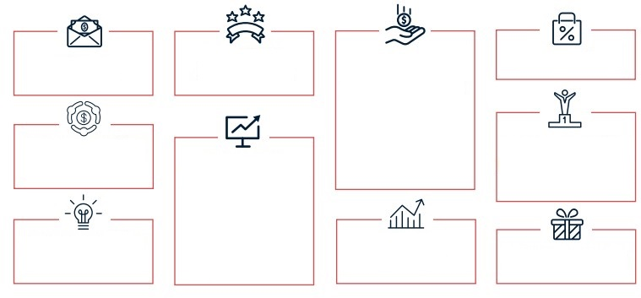
DIFFERENT FORMS OF VARIABLE COMPENSATION:
Awards and Incentives
Bonus
Commission
Profit Sharing and Results (PLR)
Employee Value Proposition (EVP)
Shareholding
Equity Compensation Plan
Strategic Remuneration
(Stock options, Restricted stock, Full-Value Award, SAR…)
Bonus Share (PPA’s)
Shareholding

Slide 13
BONIFICATION :
Bonus programmes normally provide a payment of bonus in case of achievement of expected performance.
Achieving this target, whether individual or sector-wide, entitles the employee to remuneration, the calculation of which was previously agreed with each hierarchical level of the company, usually linked to a proportional factor for a certain period.

Slide 14
PROFIT SHARING AND RESULTS - (PLR):
Differently from the payment programs with shorter terms, as usually occurs with bonuses, the option for Profit Labels Results (PLR) is usually annual and reaches all the company's employees, being calculated on profits or global results.
This type of program is not complementary to the fixed remuneration and, therefore, is not subject to labour charges, being formalized by agreement with the employees.

Slide 15
STOCK OPTIONS:
Stock Options is the most traditional model of Incentive Label Plans (ILP). In such plans, the company gives employees the option to acquire shares of the company at a predetermined price (stick price) within a given period (vesting time).
An important detail is that, as this type of plan deals with stock options and not shares, the holder gives the right to buy the share but is not obligated to execute it.

Slide 16
PERFORMANCE SHARES:
A performance share type plan grants the beneficiary a certain number of shares, provided that predetermined conditions are met for a specific period of time.
Adopting this type of plan is increasingly common because it makes it easier to identify the direct link between the increase in the company's share price and the factors that create of shareholder value in the long term.

Slide 17

Conclusion
As we've covered in this presentation, various characteristics should be evaluated to choose the compensation model that best suits the company and employees. To be successful in their implementation, plans must be well designed, easy to measure, simple to understand by the beneficiaries and, at the same time adherent to the company's short- and long-term goals.
I suggest to Sales team that in addition to their expected 2% increase in sales, add 0.5 percentage points if they achieve the company goal.
For the Customer Service team, I would suggest milestone bonus or task bonus, for completing a milestone on a goal to finish call with customers on time, and we could study the possibility of giving a bonus or percentage on sales. If the high underperformance rate is due to absences or delays, I also recommend an attendance reward method.
For Marketing team, I recommend retention bonuses, where they demonstrate increases in repeat customer rates, purchase frequency, and average order value.
For manufacturing teams, I recommend offering executive bonuses, which we can provide employees with a variety of benefits, as well as annual or vacation benefits, including retirement savings beyond qualifying plan limits.

Slide 18


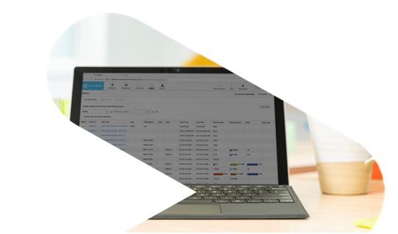
Talysson Oliveira
Data Analyst / Data Engineering

